Slide 1






Slide 2





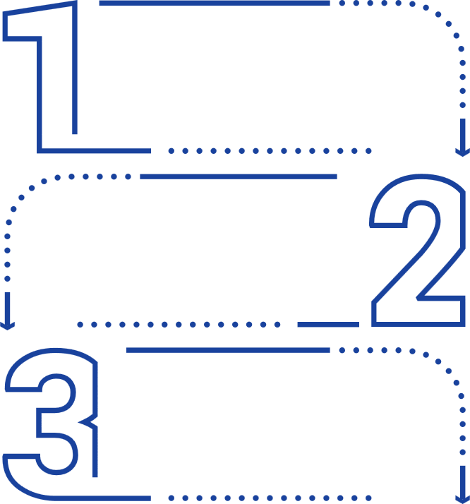




Problem Overview
Tamper-Proof Data Sharing Platform
Stakeholders Affected
Domain
The Challenges
Daily sharing of high-value sensitive data
Organizations exchanging sensitive data.
Decentralized Data Exchange
Trust between platforms is weak
Authorities verifying document integrity.
Data Integrity & Security
Central systems are high-risk
Secure collaboration is hard to scale
Users
demanding privacy and control.
Privacy-Preserving Collaboration

Slide 3

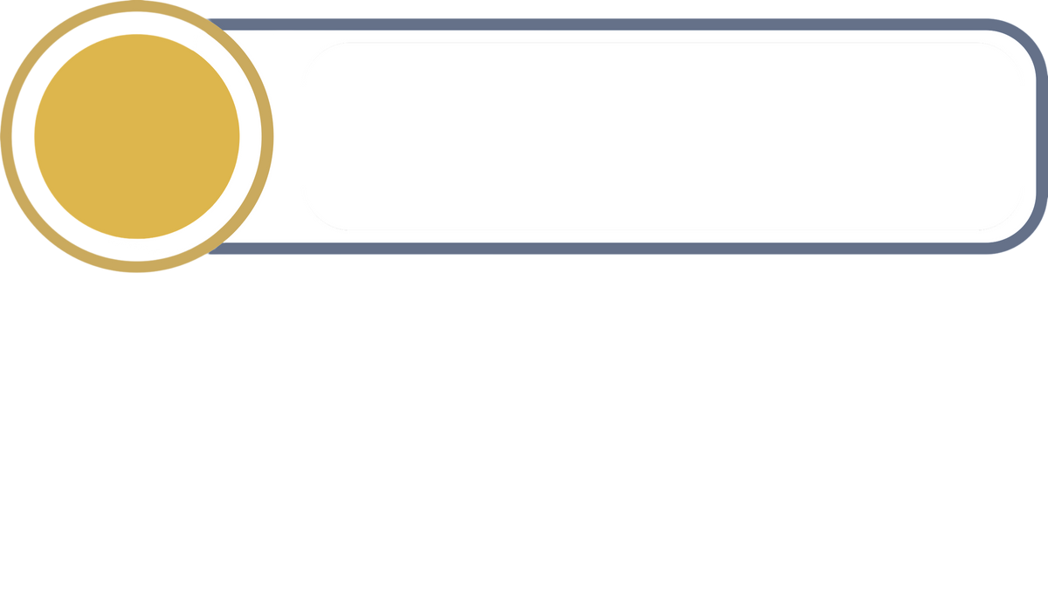





Problem Statement
Definition of the problem
Existing systems
1
Data is shared across multiple platforms
Google Drive / Google Workspace
Type: Cloud-Based Centralized
Storage
2
No guarantee of data integrity
3
DigiLocker
Type: Government Digital
Document Vault
Privacy and unauthorized access risks
Limitations
Dropbox
Type: Centralized File Hosting
Service
Centralized systems are vulnerable
Over-dependence on trust
Poor data traceability

Slide 4

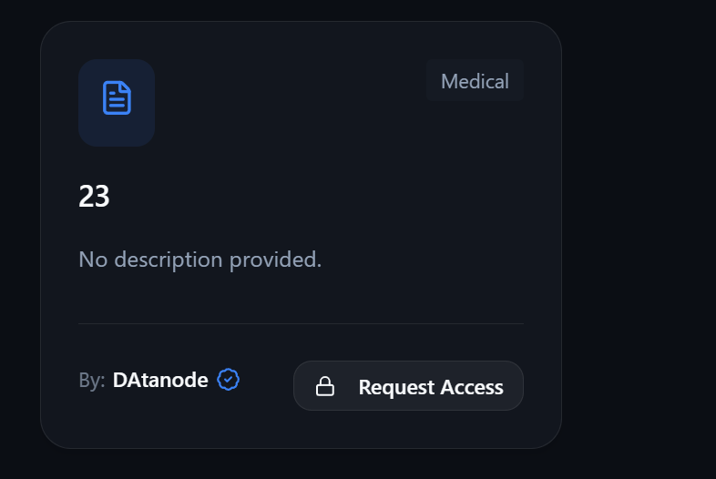
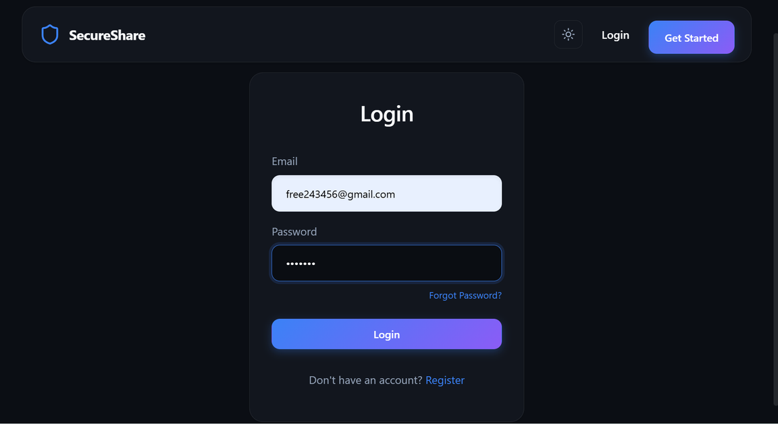


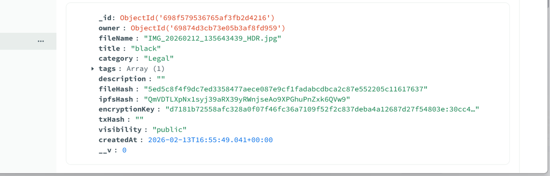



Proposed Solution
Description of the solution
A Decentralized platform for secure file sharing
and Verification using Blockchain and IPFS.
Public Integrity Check
JWT Authentication
Blockchain Hash AES-256 Encryption
End-to-End Encryption
Blockchain-based Integrity

Slide 5
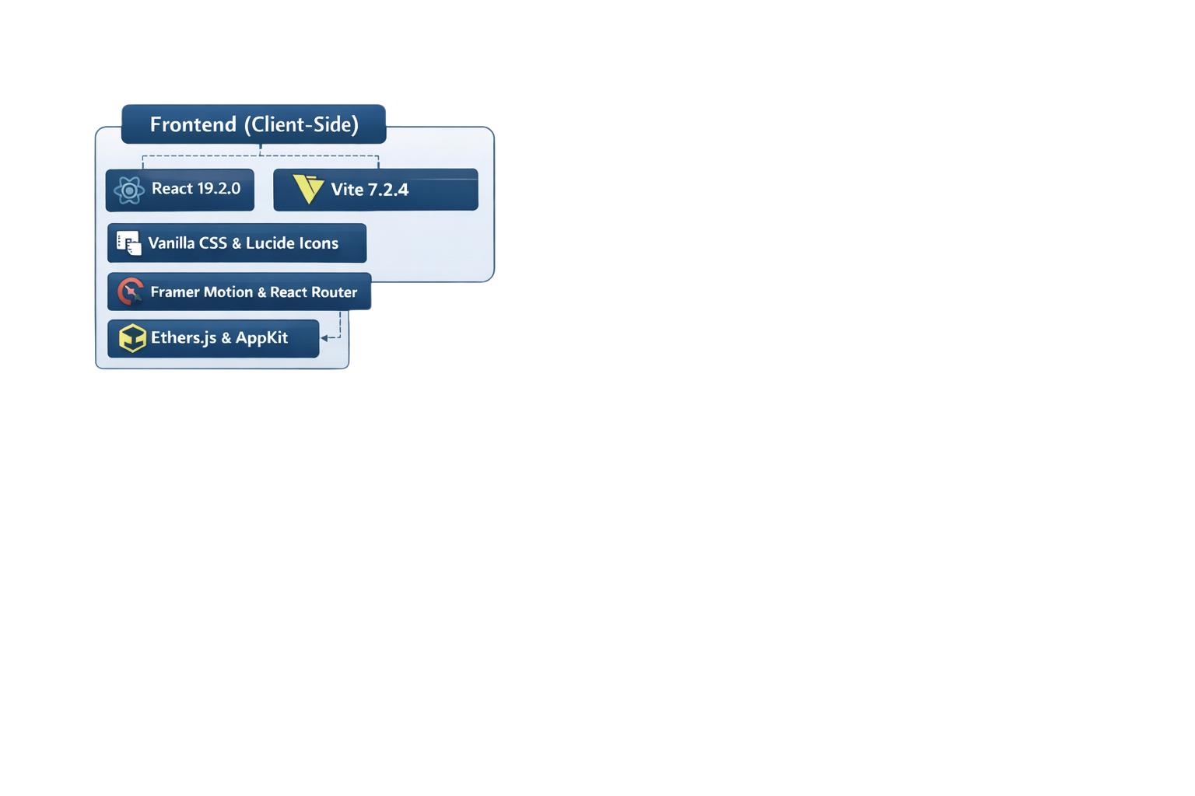
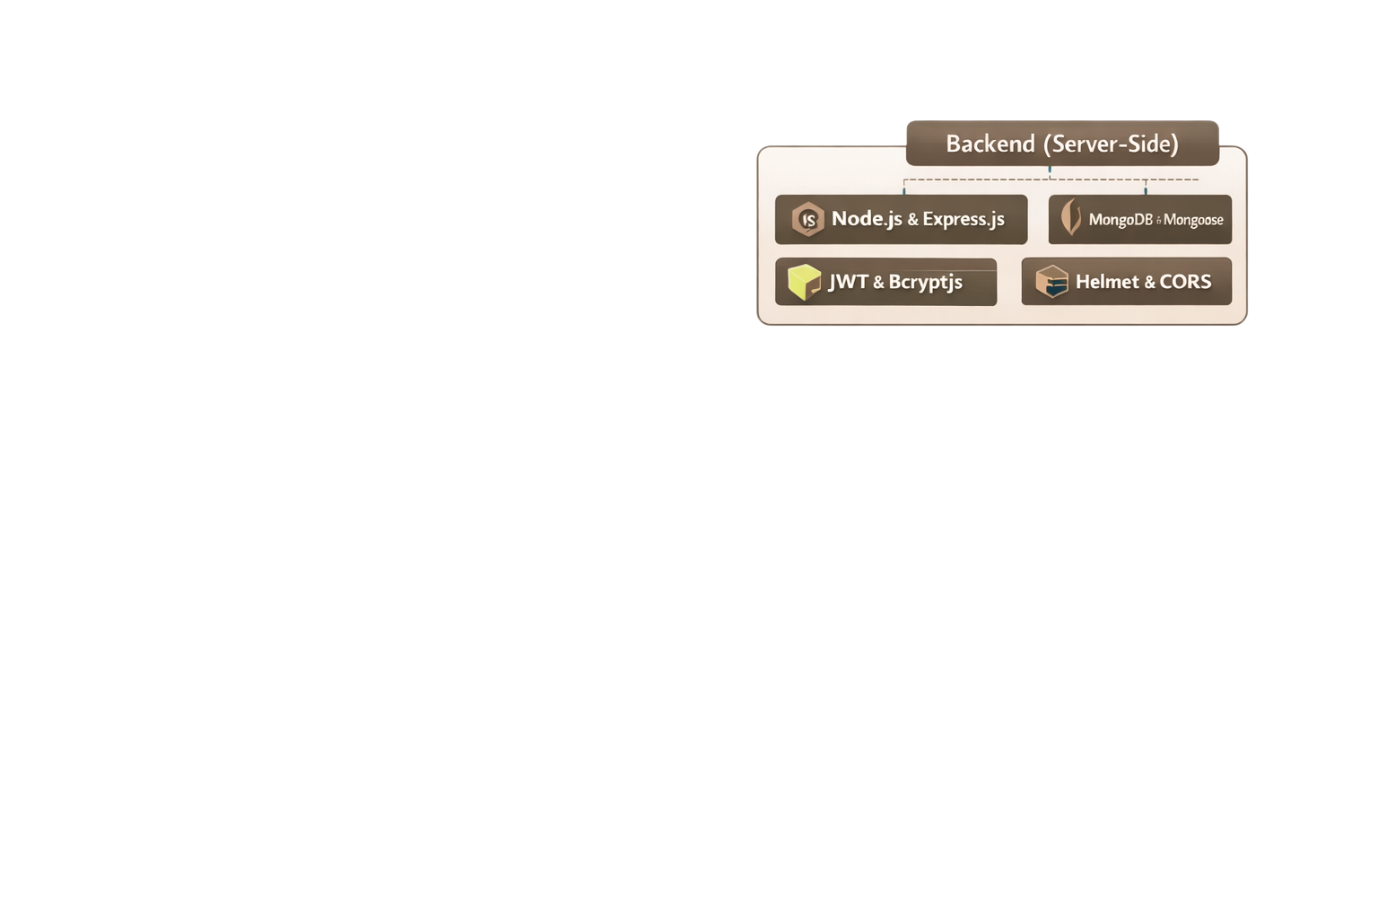
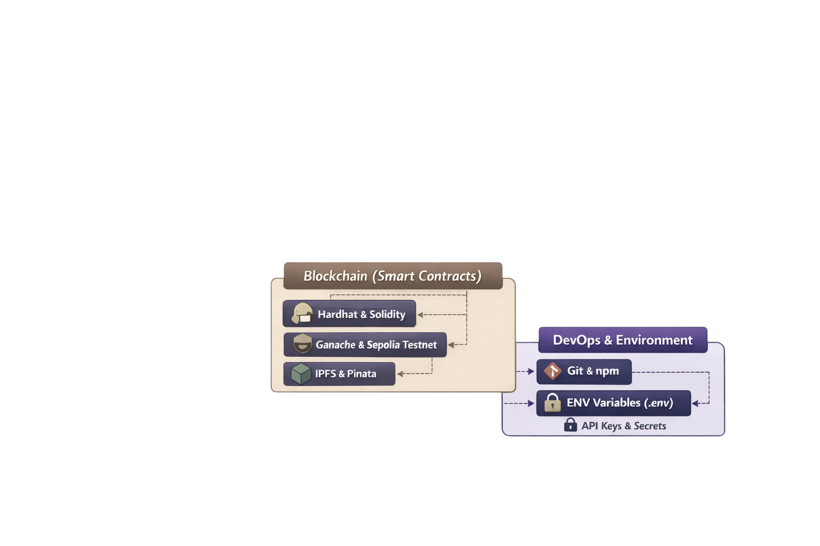
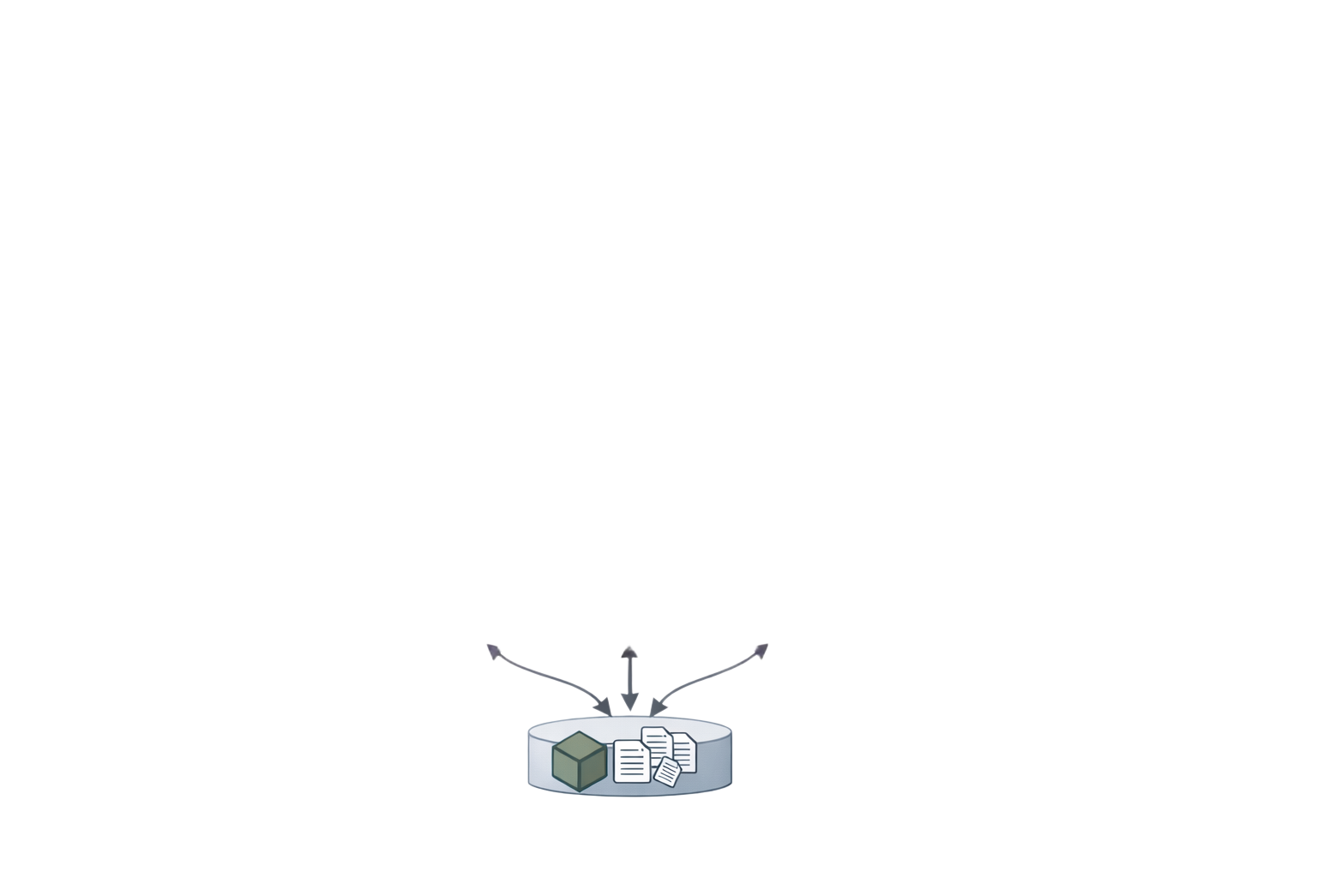
Technical Approach
Web Integration
Secure API
Decentralized Document Storage

Slide 6
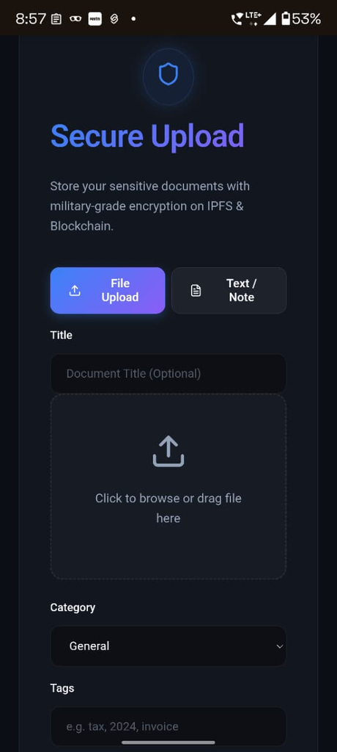



Feasibility and Impact
Practical Feasibility
Uses cloud, IPFS, and blockchain technologies
Requires minimal infrastructure changes
Impact and Benefits
Ensures secure, tamper-proof data sharing
Enables trust within organizations without intermediaries
Scalability and Sustanability
Supports large data through off-chain storage
Reduces long-term operational costs
Scalable for future security needs

Slide 7

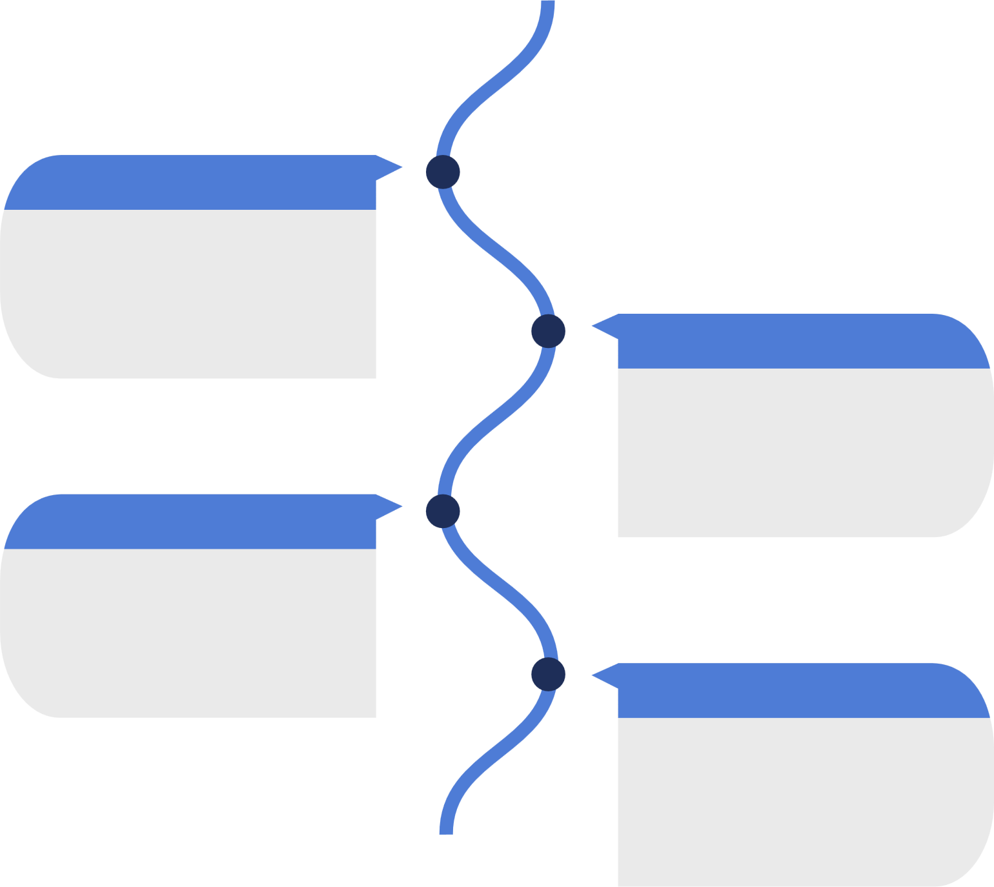


Implementation Plan
Timeline and Milestones
Dev-Approach
Future Scope
Frontend
React, App-Kit
Axios,Ethers
Phase 1
Advanced Analytics
System Analysis & Design
Backend
Role Based Access
Phase 2
Node JS, Multer
Express,Joi
Smart contract and backend implementation
Smart Contract Auditing
Blockchain
Phase 3
Multi Chain Support
Hardhat, Ganache
Sepolia , Solidity
UI Integration & System Testing
Phase 4
Storage
Testnet Deployment & Performance Check
IPFS, Pinata
MongoDB,AES-256

Slide 8



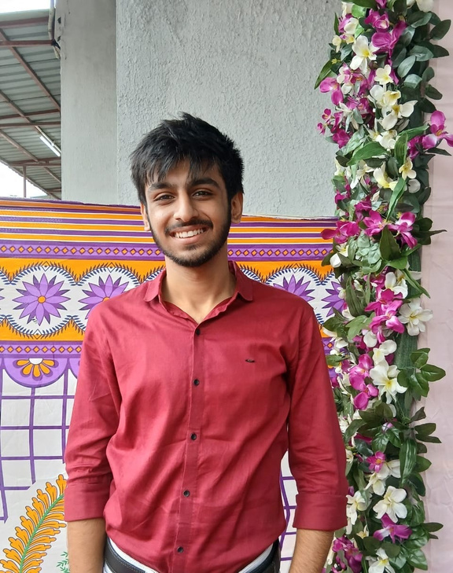

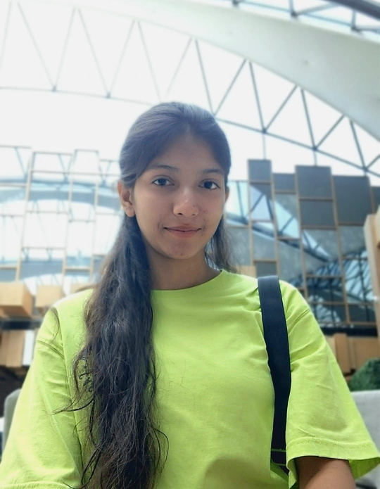
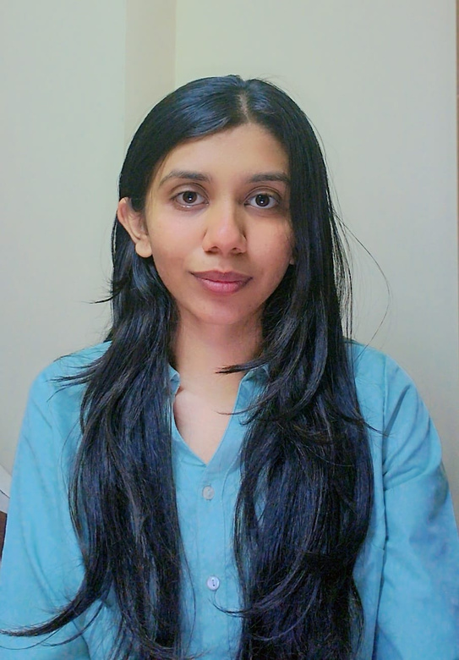


Meet Our Best Team
Dhairya Shah
Manasvi Rachi
Shifa Tirmizi
Jinal Udani
GLS University
GLS University
GLS University
GLS University
Team Leader
Tech
Non-Tech/Design
Non-Tech/Design

